Slide 1
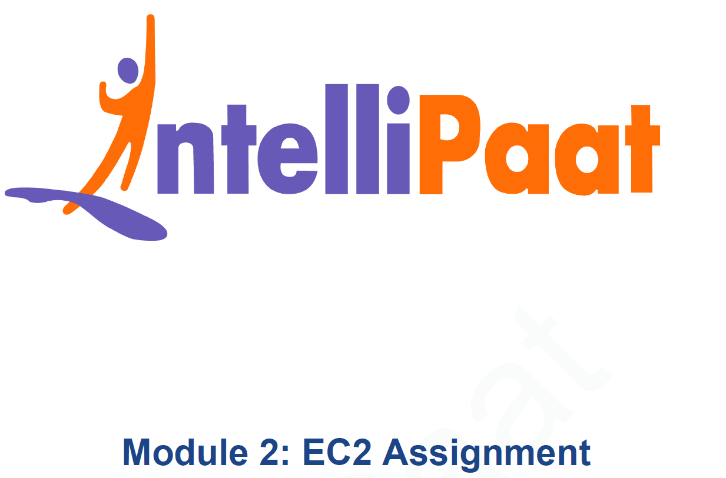
AWS Solutions Architect Training
Module-7: Database Services
SIDDHANI VAMSI SAI KUMAR
svsk2376@gmail.com
7678203747

Slide 2
You work for XYZ Corporation. Their application requires a SQL service that can store data which can be retrieved if required. Implement a suitable RDS engine for the same.
While migrating, you are asked to perform the following tasks:
MariaDB:
Problem Statements:
1. Create a MariaDB Engine based RDS Database.
2. Connect to the DB using the following ways:
a. SQL Client for Windows
b. Linux based EC2 Instance
AuroraDB:
1. Create an AuroraDB Engine based RDS Database.
2. Create 2 Read Replicas in different availability zones for better infrastructure availability.
DynamoDB:
1. Create an AuroraDB Engine based RDS Database.
2. Create 2 Read Replicas in different availability zones for better infrastructure availability.
Redshift:
1. Create a Redshift Data warehouse.
2. Using the query editor:
a. Load some data
b. Query the data

Slide 3
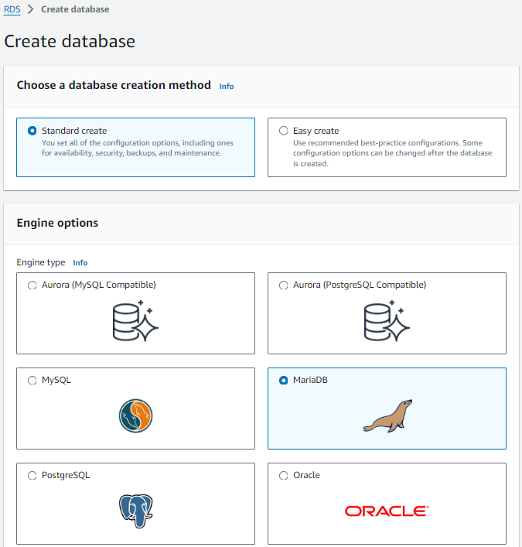
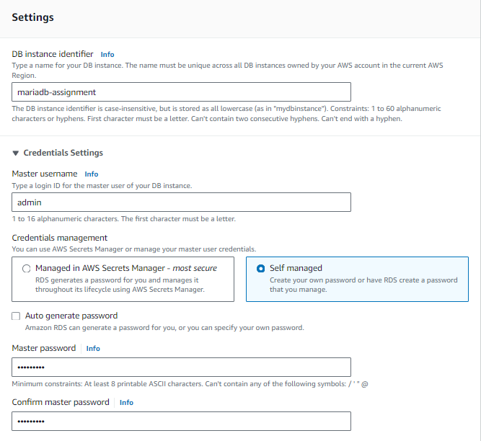
TASK – MariaDB Assignment
Go to AWS Management Console → RDS → Databases → Create Database
Templates → Free Tier
Choose standard create
Choose MariaDB

Slide 4
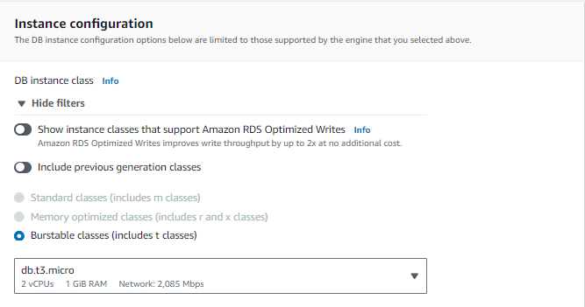
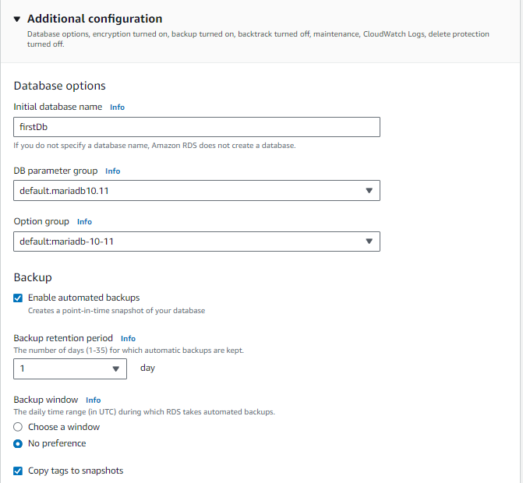
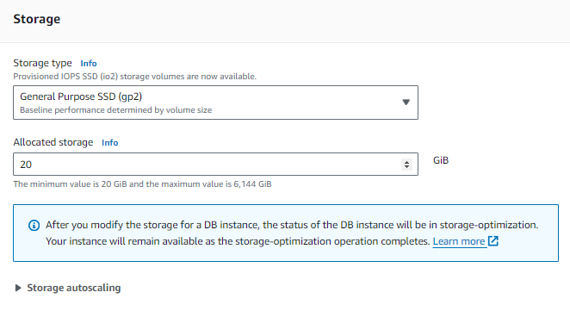
TASK – MariaDB Assignment
Keep default settings for Connectivity, Tags and Database Authentication
Go to Additional Configuration →
Give a name to the initial database
Keep the remaining settings to defaults and click on Create

Slide 5
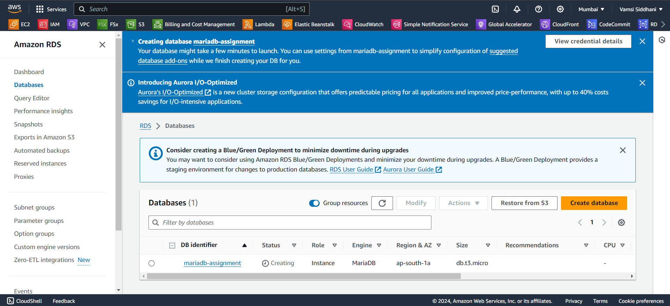
TASK – MariaDB Assignment
It takes some time to create this database. Meanwhile download and install MySQL Workbench.

Slide 6
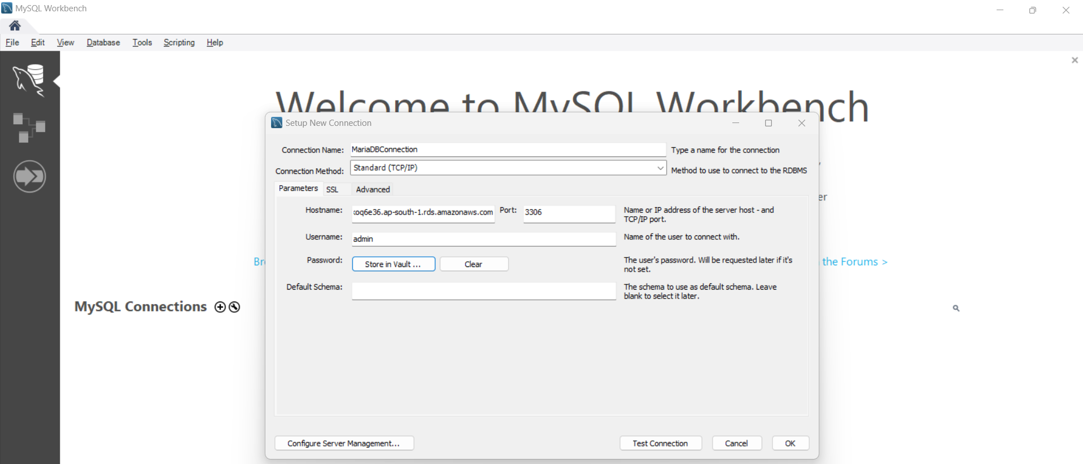
TASK – MariaDB Assignment
Now open MySQL workbench and enter the required details. Click on Store in Vault to enter the password.
Click on Test Connection

Slide 7
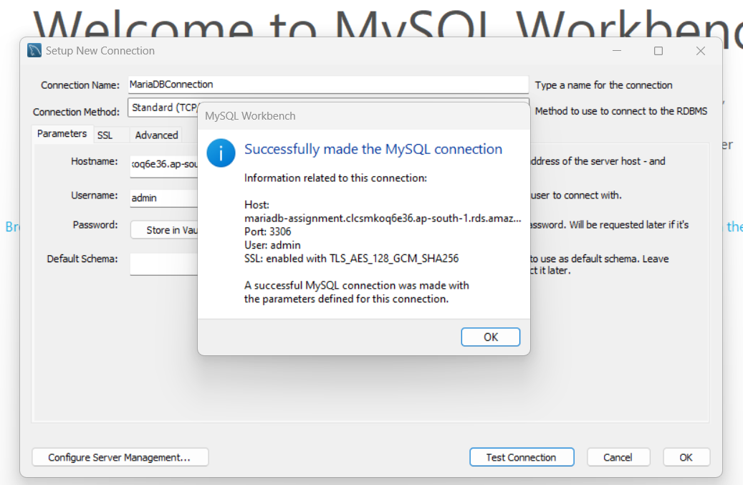
TASK – MariaDB Assignment
Connection successful

Slide 8
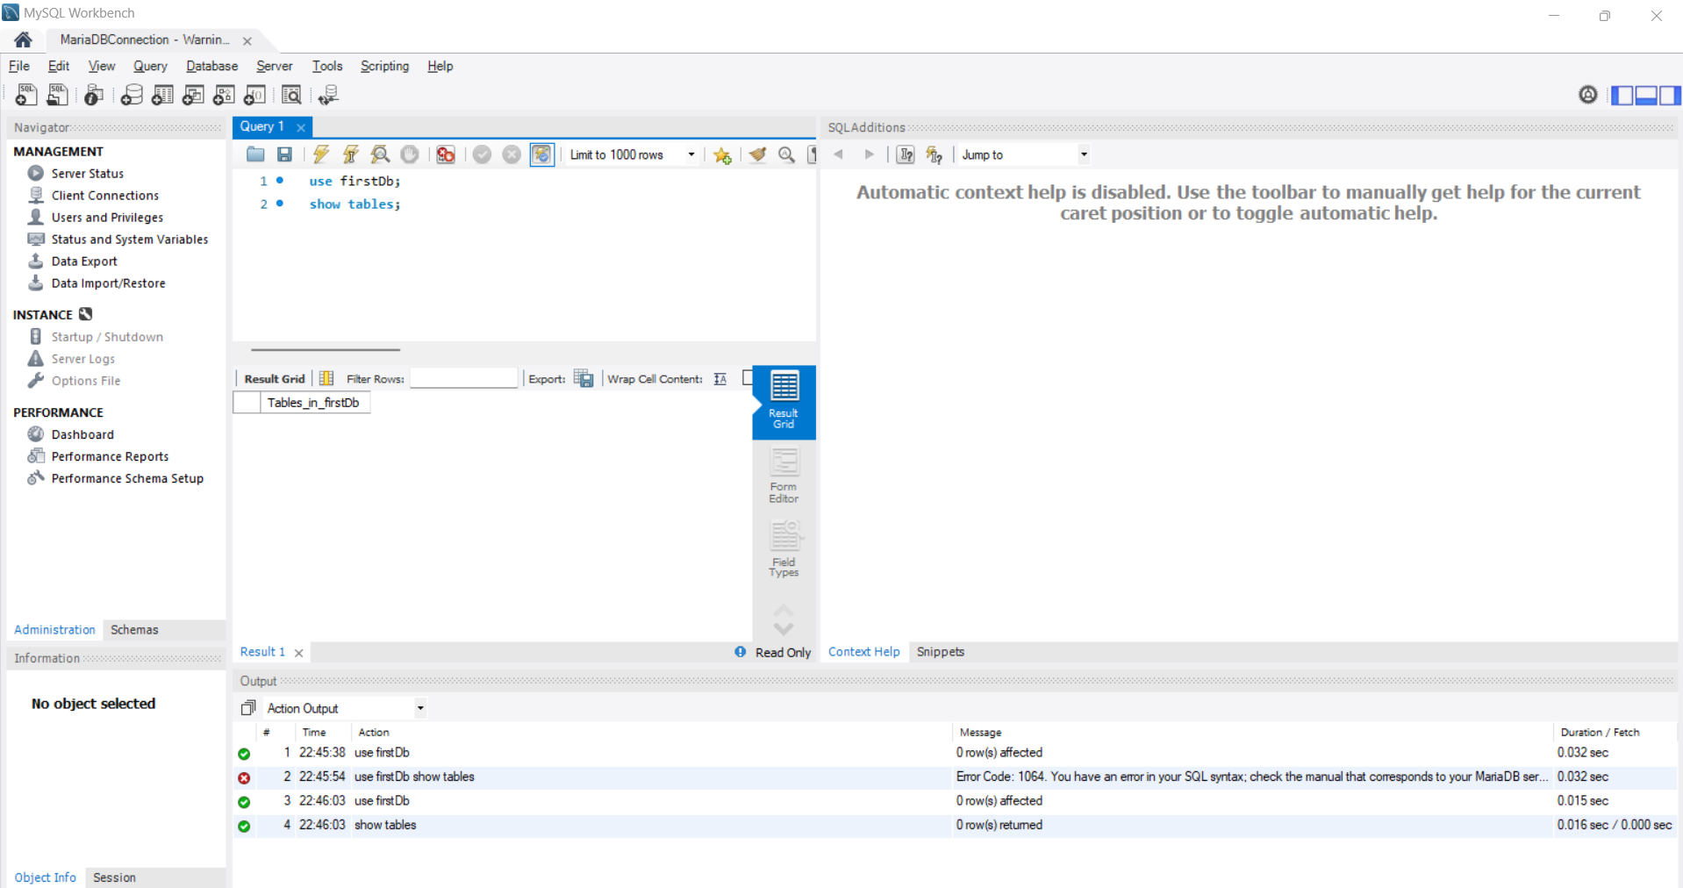
TASK – MariaDB Assignment
You can now run SQL queries and manage your database from the SQL client.

Slide 9
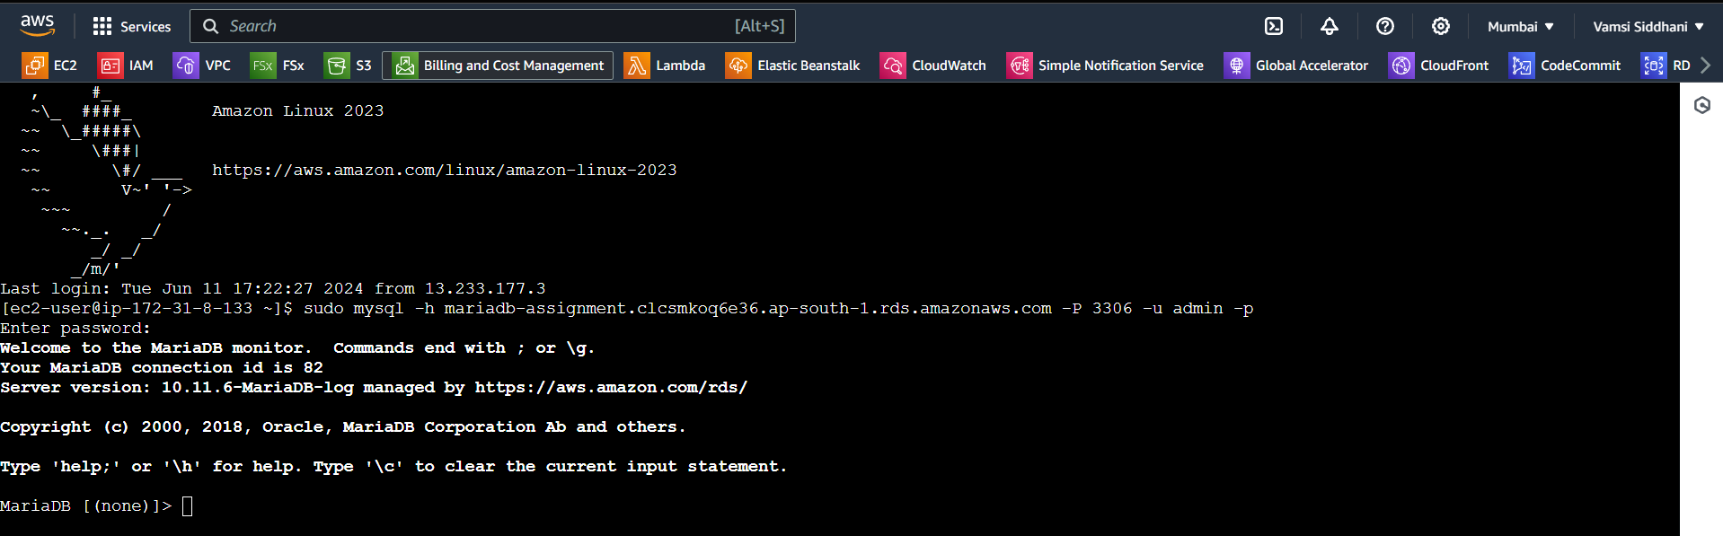
TASK – MariaDB Assignment
Let’s Connect to the DB using a Linux-Based EC2 Instance. Create an Amazon Linux instance in the same VPC as the database.
Then install MariaDB client.
sudo yum update -y >>>>> sudo yum install mariadb105 –y
Note the Endpoint and Port from the RDS console as mentioned before.
Connect to MariaDB using the below command mysql -h <endpoint> -P <port> -u <username> -p
mysql –h mariadb-assignment.clcsmkoq6e36.ap-south-1.rds.amazonaws.com –P 3306 –u admin –p
Enter password when prompted
It is successfully connected. you can run SQL commands directly from the terminal.

Slide 10
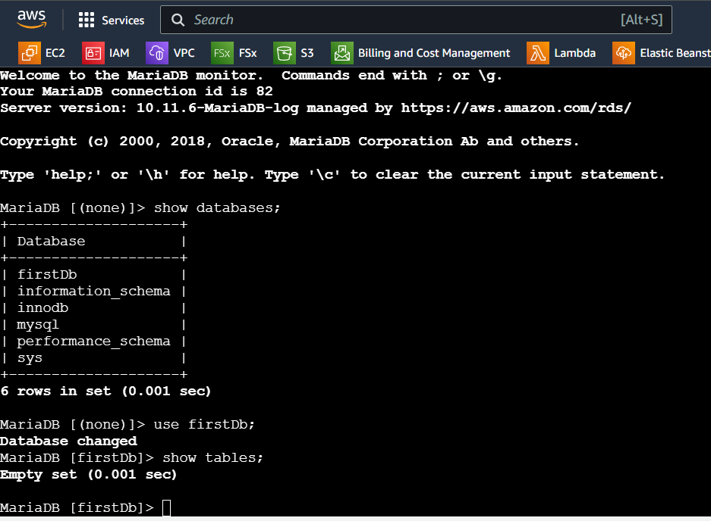
TASK – MariaDB Assignment
We’ve successfully set up a MariaDB RDS instance and connect to it from both a Windows SQL client and a Linux-based EC2 instance.
Next, we’ll do AuroraDB Assignment

Slide 11
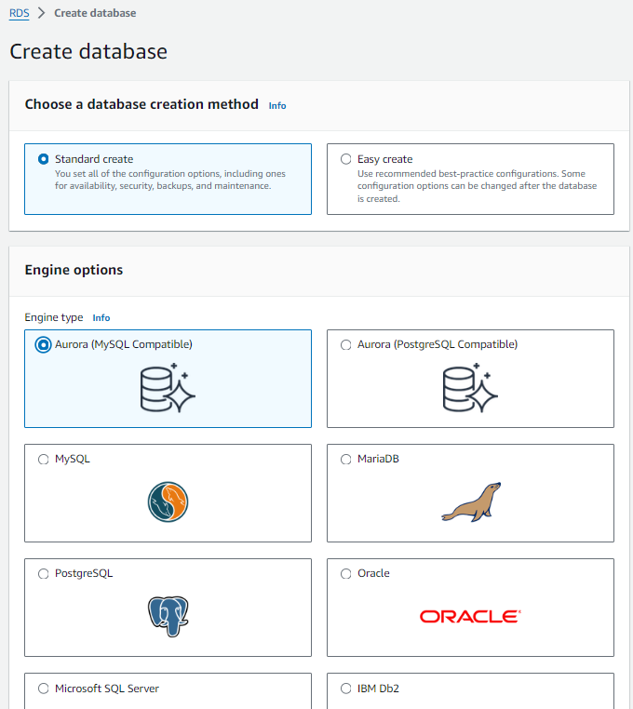
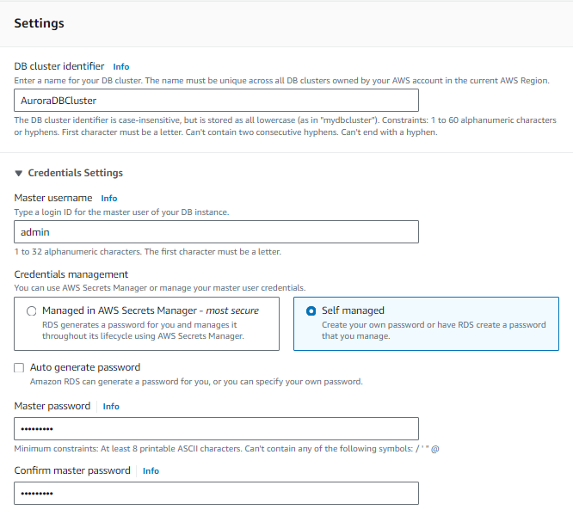
TASK – AuroraDB Assignment
Go to AWS Management Console → RDS → Databases → Create Database
Templates → Dev/Test
Choose standard create
Choose AuroraDB

Slide 12
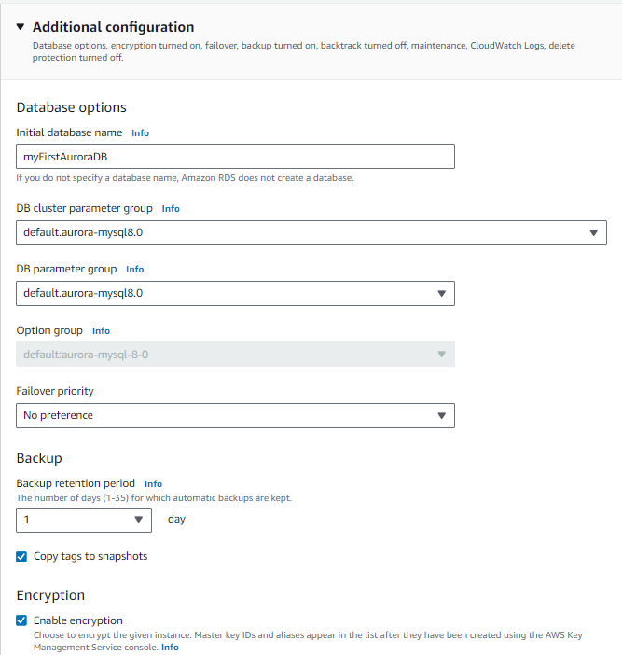
TASK – AuroraDB Assignment
Keep default settings for Connectivity, Tags and Database Authentication
Go to Additional Configuration →
Give a name to the initial database
Keep the remaining settings to defaults and click on Create

Slide 13
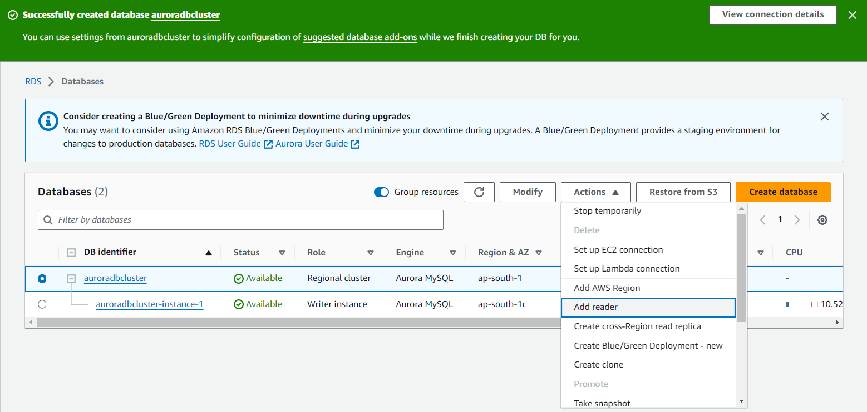
TASK – AuroraDB Assignment
database is created and is available now.
Let’s create read replicas in 2 different Azs. Go to Actions -> Add reader

Slide 14
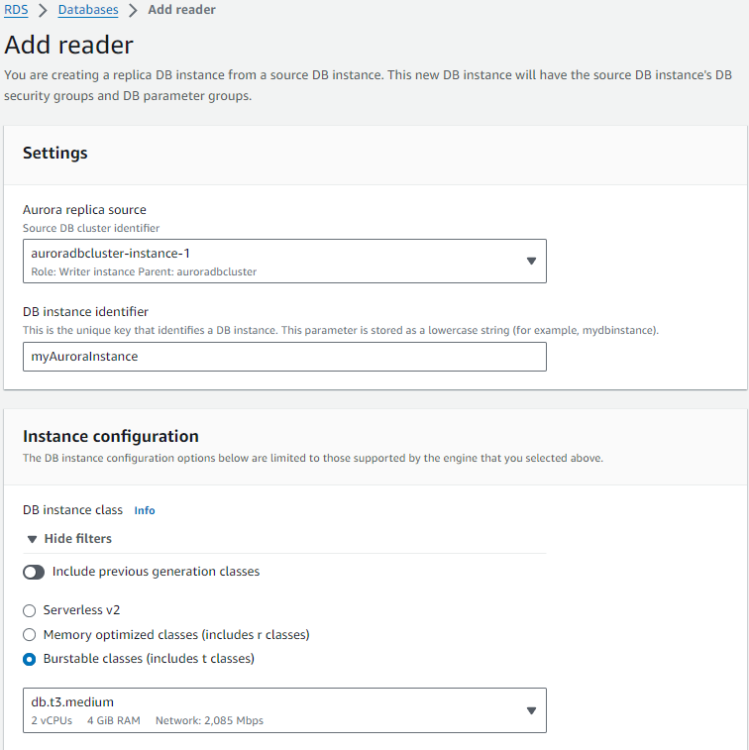
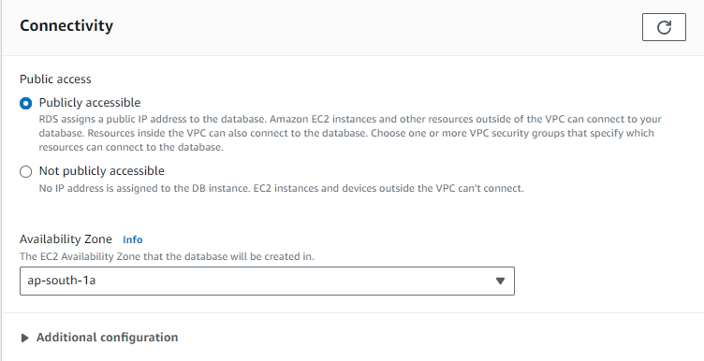
TASK – AuroraDB Assignment
Keep the remaining settings to defaults and click on Add Reader

Slide 15
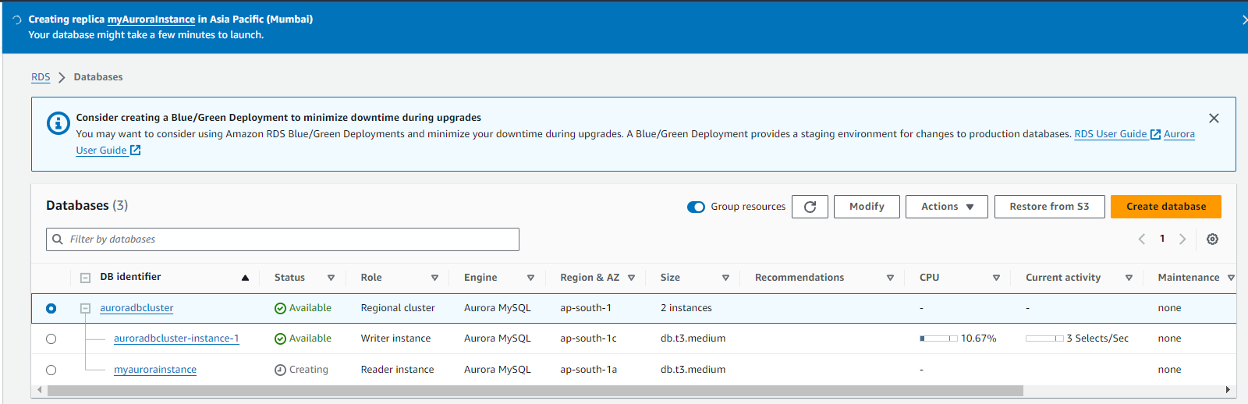
TASK – AuroraDB Assignment
Read replica is getting created. Meanwhile, we go and create another read replica in a different AZ.
Choose cluster → Go to Actions -> Add reader

Slide 16
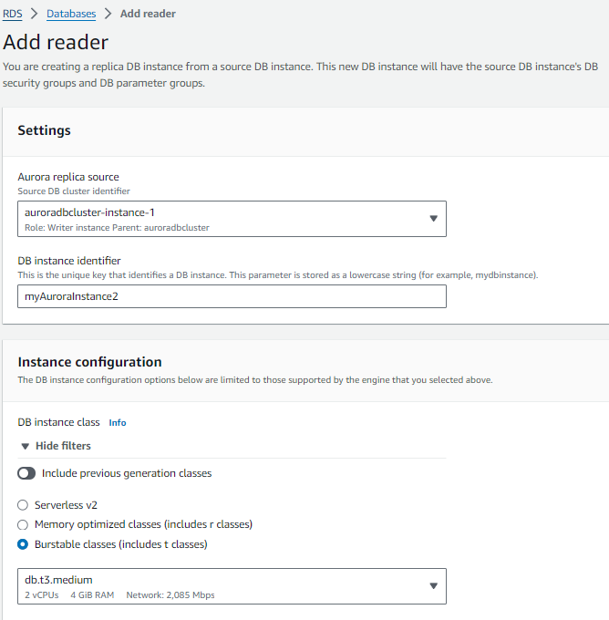
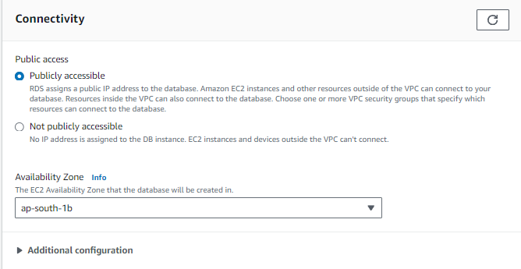
TASK – AuroraDB Assignment
AZ is ap-south-1b.
Keep the remaining settings to defaults and click on Add Reader
Similarly it’ll create one more read replica and you can run SQL commands directly from the terminal. Let’s proceed to 3rd assignment on DynamoDB

Slide 17
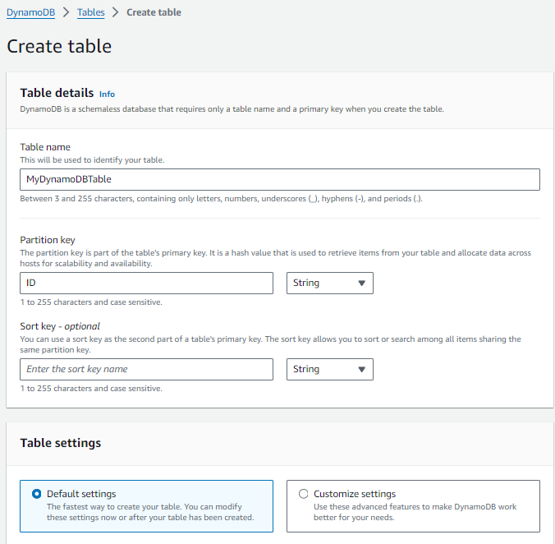
TASK – DynamoDB Assignment
Go to AWS Management Console → DynamoDB → Create Table
Keep the remaining settings as it is and click on Create Table
AWS will create the table, which may take a few moments.

Slide 18
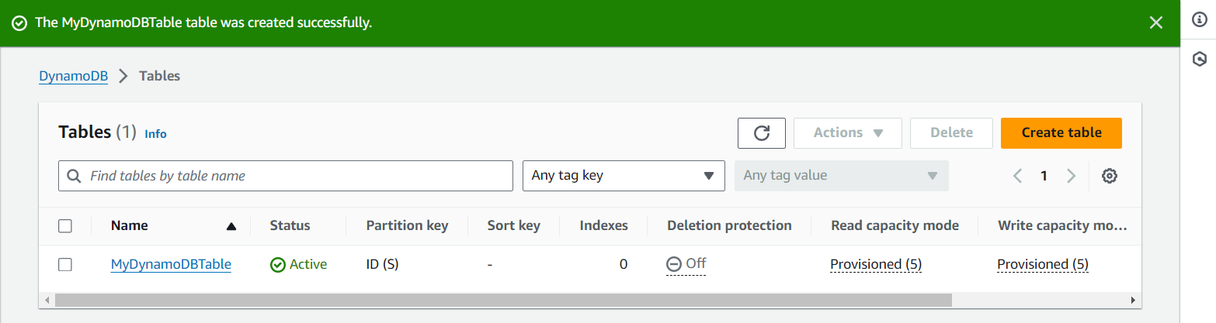
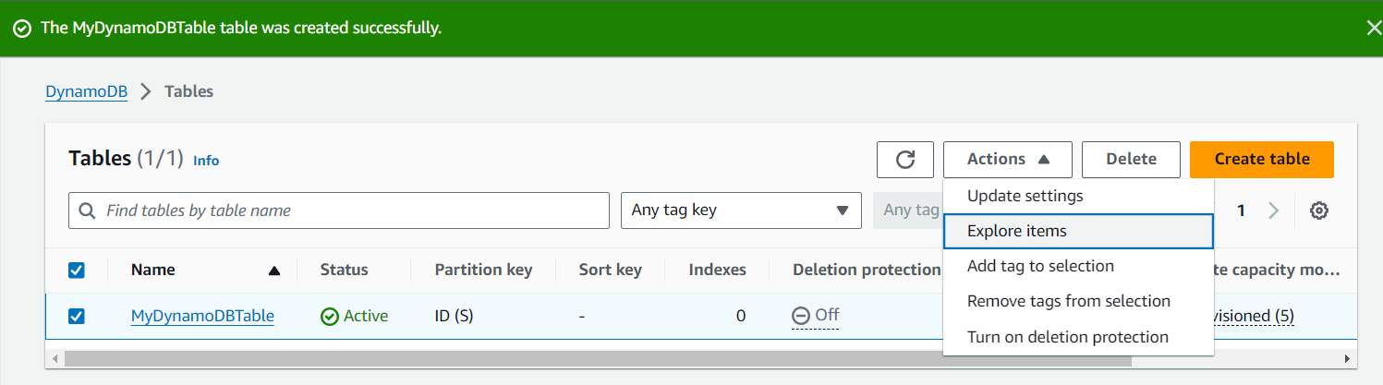
TASK – DynamoDB Assignment
Table is ready. Let’s add 5 Items to this Table
Click on Explore Items

Slide 19
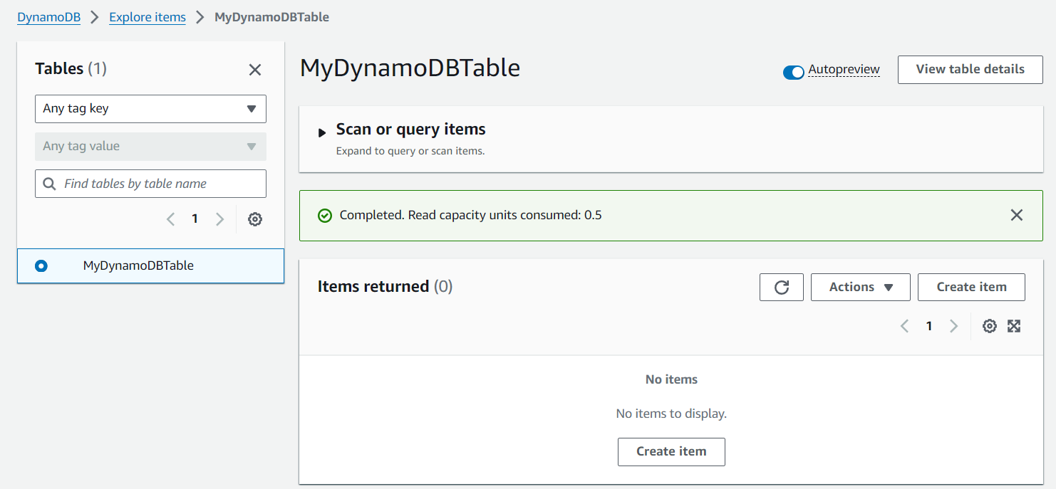
TASK – DynamoDB Assignment
Click on Create Item

Slide 20
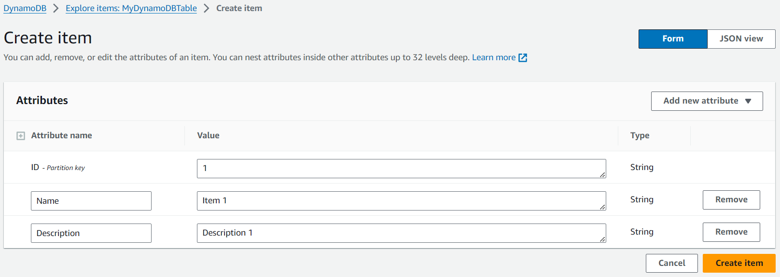
TASK – DynamoDB Assignment
Add the required attribute and their values and Click on Create Item
Similarly create 4 more items

Slide 21
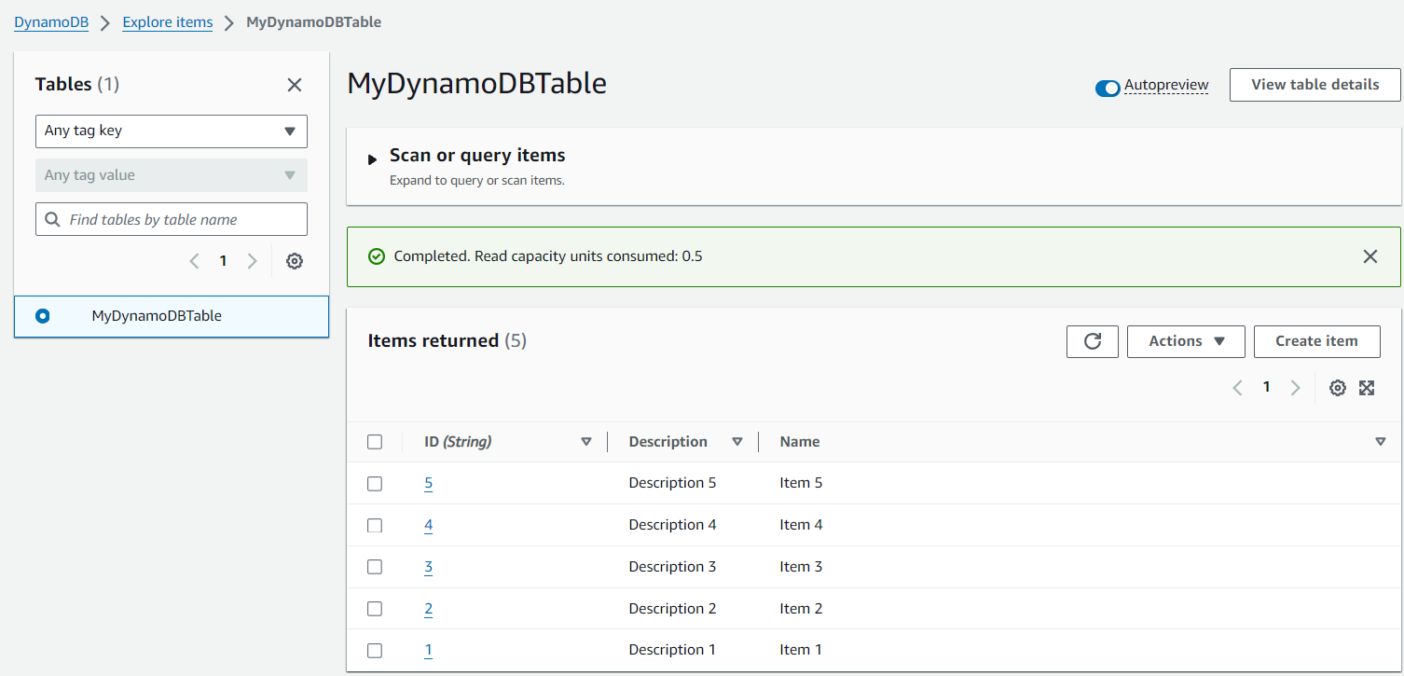
TASK – DynamoDB Assignment
5 Items are added successfully
Let’s take the backup and delete this table. Go to Backup from the left menu

Slide 22
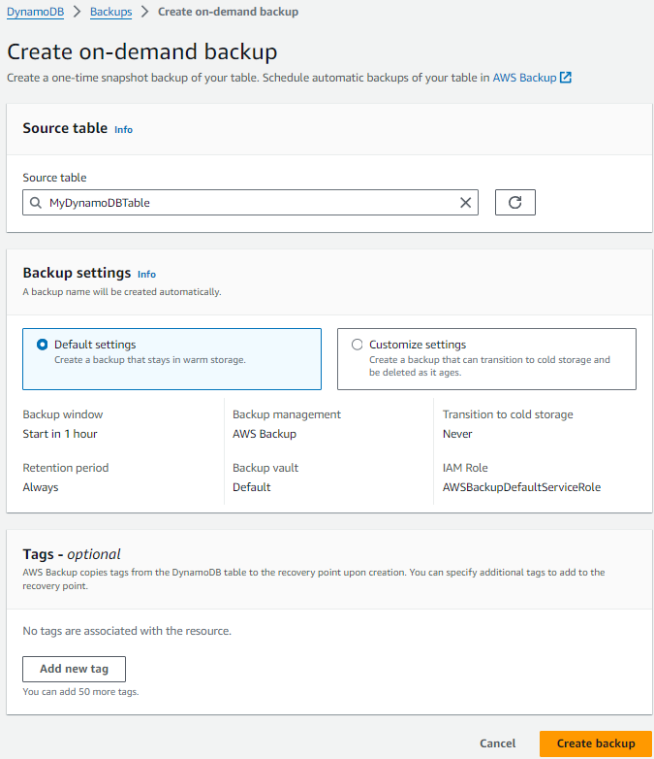
TASK – DynamoDB Assignment
Click on Create backup

Slide 23
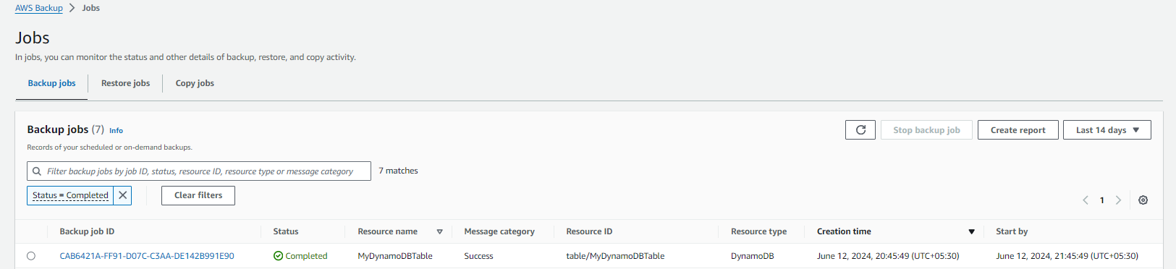
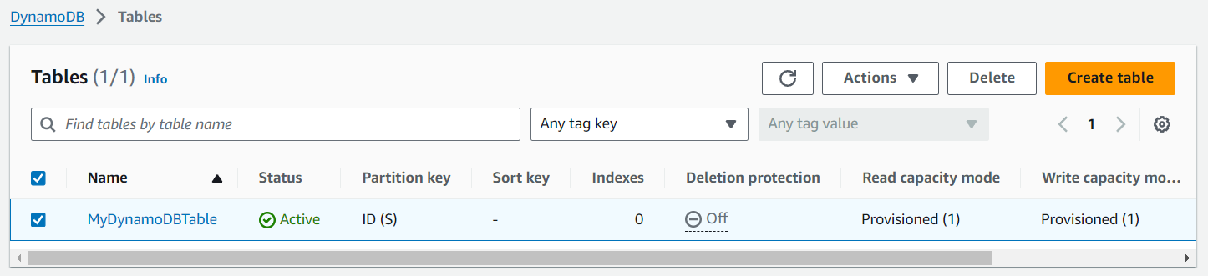
TASK – DynamoDB Assignment
Backup job is created. It’ll take some time to backup the table. we can go and delete the table
Select the table and click on Delete.

Slide 24
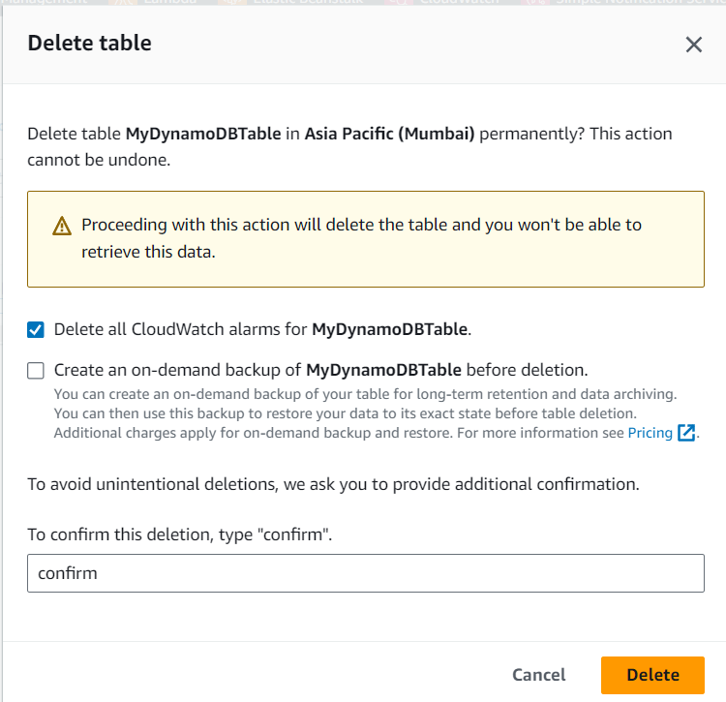
TASK – DynamoDB Assignment
click on Delete.
DynamoDB assignment is complete. Let’s start Redshift assignment.

Slide 25
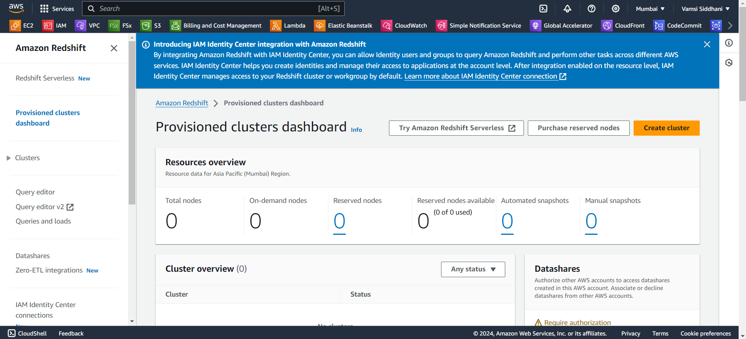
TASK – Amazon Redshift Assignment
Go to AWS Management Console → Amazon Redshift → Provisioned clusters dashboard → Create Cluster

Slide 26
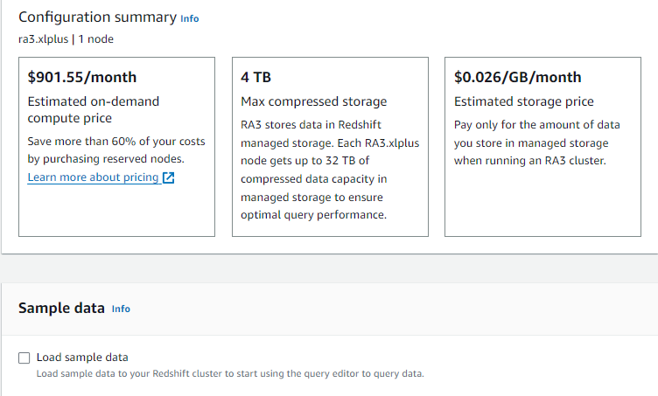
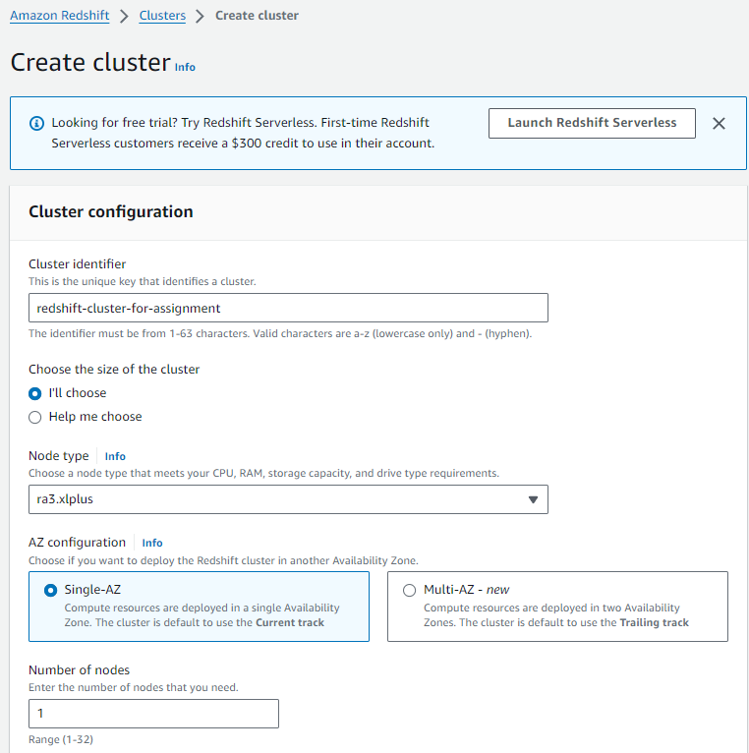
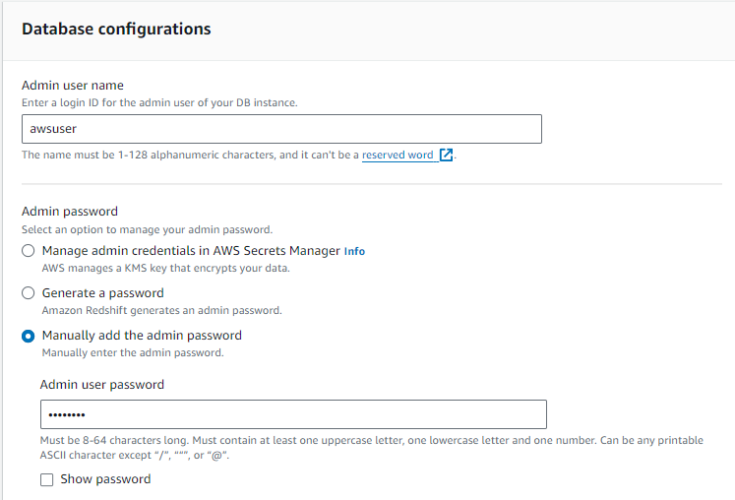
TASK – Amazon Redshift Assignment
Keep the remaining settings as it is and click on Create Cluster

Slide 27
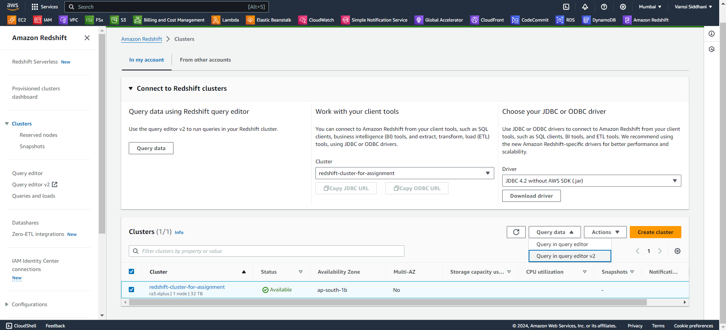
TASK – Amazon Redshift Assignment
Cluster got created. Let’s open the query editor

Slide 28
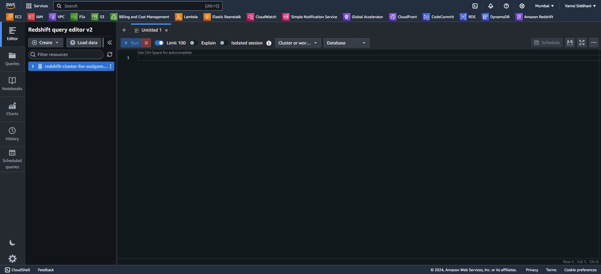
TASK – Amazon Redshift Assignment
The below page will be opened. Select the cluster.

Slide 29
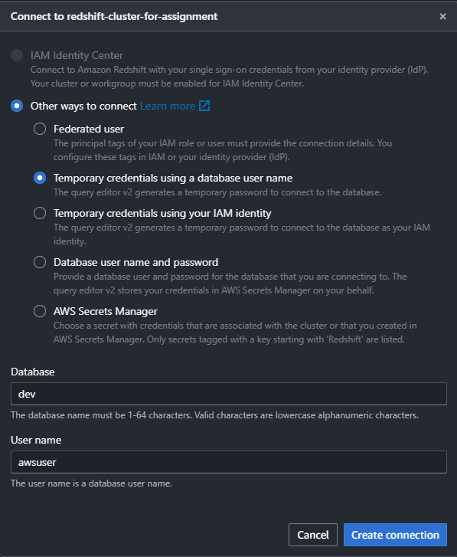
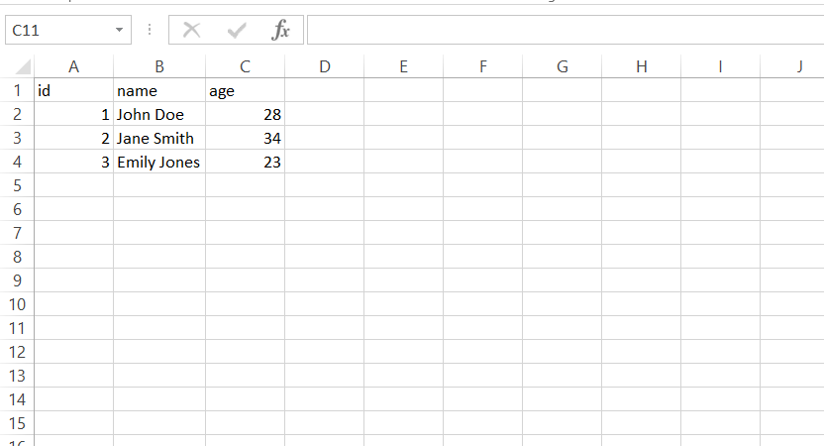
TASK – Amazon Redshift Assignment
This page will be opened.
Choose temporary credentials and enter the username chosen in the previous step.
Let’s create a csv file and upload it to s3.

Slide 30
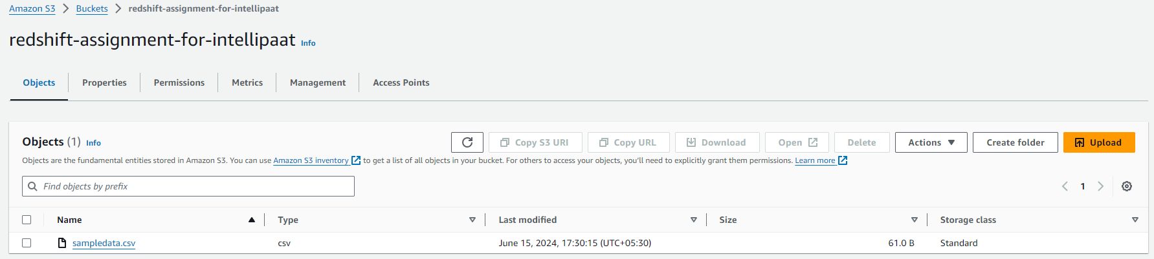
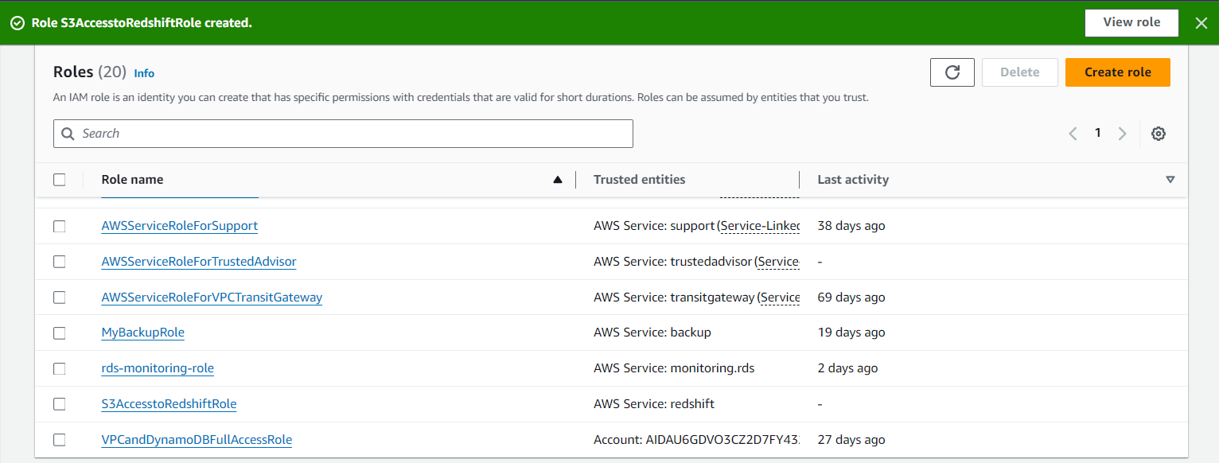
TASK – Amazon Redshift Assignment
CSV file is uploaded to S3 bucket.
Let’s go to IAM and create a new role with permissions to access S3 and then Attach the role to our Redshift cluster.
Created a role for Redshift to access S3. Let’s Attach it to our Redshift cluster.

Slide 31
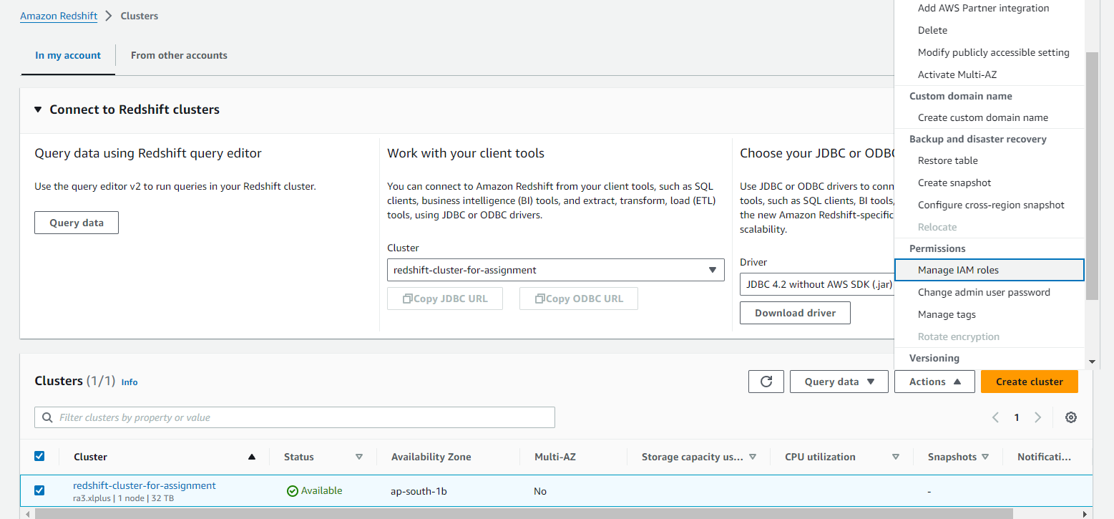
TASK – Amazon Redshift Assignment
Choose the cluster → Actions → Manage IAM roles

Slide 32
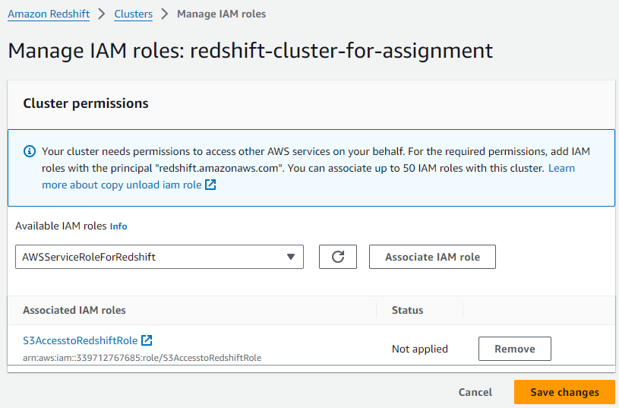
TASK – Amazon Redshift Assignment
Created a table using the query: CREATE TABLE sample_table (
id INT,
name VARCHAR(50),
age INT
);
Then executed the following SQL command to copy data from S3 bucket:
COPY sample_table
FROM 's3://redshift-assignment-for-intellipaat/sampledata.csv'
IAM_ROLE 'arn:aws:iam::339712767685:role/S3AccesstoRedshiftRole'
CSV
IGNOREHEADER 1;
Query is successful. It loaded 3 records into the table sample_data
click on Associate and Save.

Slide 33
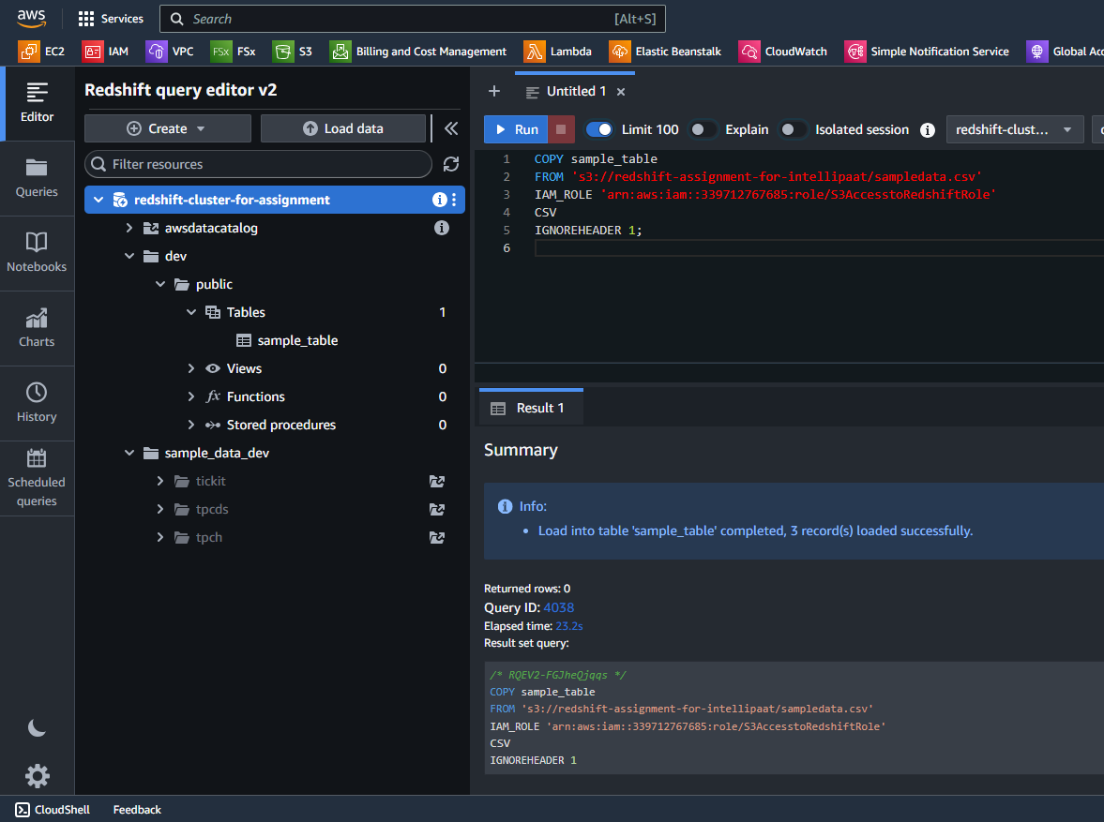
TASK – Amazon Redshift Assignment

Slide 34
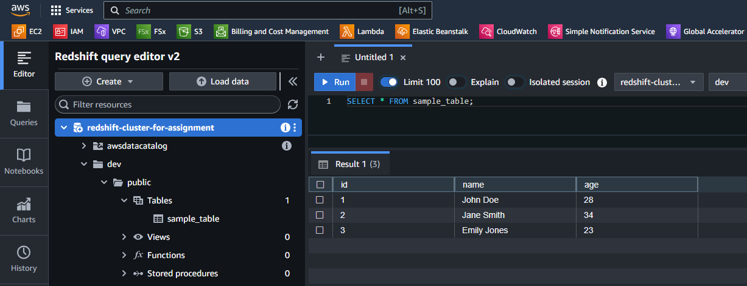
TASK – Amazon Redshift Assignment
Query the table to ensure the data has been loaded:
SELECT * FROM sample_table;
This completes our assignment.

Slide 35
Summary
Created a MariaDB RDS Database.
Connected to the DB using SQL Client on Windows.
Connected to the DB using a Linux-Based EC2 Instance.
Created an AuroraDB database
Created 2 read replicas in different AZs.
Created a DynamoDB table
Added 5 items into this table.
Created backup of this table and deleted it.
Created a Redshift data warehouse
Created a cluster
Executed sql queries for create table
Created an IAM role for redshift to access S3.
Uploaded a csv file to s3 bucket and copied csv data to the above table
Then executed sql query to verify the data loading.

Slide 36

Thank You.

